Slide 1
Final exam - Semester 2 (June/July, 2024)
90 minutes, in-class written test
Test Structure
40 MULTIPLE CHOICE QUESTIONS
Chapters 5 + 6: 20 fallacy questions
Chapter 11: 10 inductive reasoning questions
Chapter 7: 4 diagramming questions
Chapter 7: 4 standardization questions
Chapter 8: 2 refutation questions
40 points
20 points
16 points
16 points
8 points
Total: 100 points
Notes:
In this test structure, you’ll see the chapters you must review. Chapters 5, 6, 7, 8 are after the mid-term exam, and Chapter 11 was combined with Chapter 3 before the mid-term exam.
There will be some questions of theory about the 6 types of inductive argument: how to increase the inductive strengths which such elements as sample size, representation, correlation, similarity, dissimilarity, reliability, credibility, and so on; what word/phrase should be used to increase the strength of the conclusion

Slide 2
Contents
Eleven fallacies of relevance
Nine fallacies of insufficient evidence
Analyzing short arguments
Standardizing arguments with missing elements
Paraphrasing arguments
Refuting arguments
Key concepts of Chapter 11 and how to increase the strength of 6 types of inductive arguments

Slide 3
Fallacies of relevance
Chapters 5 + 6
Fallacies of insufficient evidence
1. Personal attack (Ad Hominem)
2. Attacking the motive
3. Look who’s talking (Tu Quoque)
4. Two wrongs make a right
5. Scare tactics (Appeal to force)
6. Appeal to pity
7. Bandwagon (Appeal to popularity)
8. Straw man
9. Red herring
10. Equivocation
11. Begging the question (Circular reasoning)
Inappropriate appeal to authority
Appeal to ignorance
False alternatives
Loaded question
Questionable cause
Hasty generalization/composition
Division
Slippery slope
Weak analogy
Inconsistency

Slide 4
Fallacy or not a fallacy?
Tom could describe many details in the victim’s house. He must have been there and murdered her.
Every part of this chair is light. So, this chair is not heavy.
Smoking causes cancer because my father was a smoker and he died of lung cancer.
Feminism is wrong because it claims that all women are saints and all men are rapists.
God does not exist because every argument for the existence of God has been shown to be unsound.

Slide 5
Fallacy or not a fallacy?
The last three times I have had a cold I took large doses of vitamin C. On each occasion, the cold cleared up later. So I’m sure vitamin C helps me recover from colds.
The Labor Union’s request for more funding for higher education should be ignored. This is because it is put forward by the very people - university staff - who would benefit from the increased money.
Children become able to solve complex problems and think of physical objects objectively at the same time that they learn language. Therefore, these abilities are caused by learning a language.
If cheap things are no good then this cheap watch is no good. But this watch is actually quite good. So some good things are cheap.
Man is rational. Women are not men. Therefore, women are not rational.

Slide 6
Fallacy or not a fallacy?
Don’t be silly! Very few people today think that UFOs exist. So, it is more than clear that UFOs don’t exist.
What John Craig says about nuclear disarmament is surely incorrect. Is he a political scientist? No. A politician with experience in foreign policy matters? No. I'll tell you what he is, he's a commercial baker, a cookie maker!
My opponent in this election doesn't deserve your vote. He's a liar and he's twice been convicted of spying for Russia.
(The president of the Spanish Bullfight Association is talking to a female journalist): Women have rights. But women are not accepted for fighting bulls because a bullfighter is and should only be a man.
Students have argued that we should offer a greater variety of food services in the Student Union. These students can't be serious. Do they expect us to open a white shark fin or red lobster type of restaurant in the Student Union building? Such a proposal is ridiculous!

Slide 7
Fallacy or not a fallacy?
I don't feel guilty about cheating on my wife. She cheated on me when we just got married.
Union representative: We'd like a 5% wage in­crease effective November 1 of this year, and hereafter, annual increases equal to the cost of living increase.
Management representative: Hey, I'd like a lot more money, too. Everyone would like to be rich. Gee, it'd be nice to afford dinner out every night, and a new car every year, but this is the real world. We can't afford to give everyone every­thing they want.
18. Alice: I can't accept the plan; we'd be causing too much environmental damage. And given that our product is, in truth, not that essential, such damage is not ethically justified.
Bert: But if we don't cut down those trees, someone else will, you know it.
Look at these pictures of starving children in Africa. Look at their swollen bellies, their bony little arms and legs, their emaciated faces. Next time you go out to a nice restaurant, think of their little hands outstretched to you, begging for a morsel of food. Please donate your heart to the Children's Famine Relief Fund. The children need your help now!
If today we do the extra review quiz well within the time limit and do more exercises in the textbook, we can be confident in the final exam. This is because the quiz questions are said to be samples of the final exam, and textbook exercises enhance our knowledge and skills.

Slide 8
Chapter 7
Paraphrasing
Filling in missing premises or conclusion
Diagramming

Slide 9
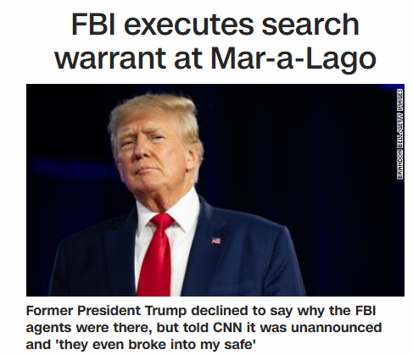
Paraphrasing
CHAPTER 7 - ARGUMENT STANDARDIZATION
Select the best paraphrase and explain why you don’t choose the others:
A. Unable to explain why the FBI agents were there, ex-President Trump still told CNN about his safety being broken in an unannounced search warrant.
B. Though refusing to explain the FBI agents’ presence at Mar-a-Lago, ex-President Trump told CNN about their unexpected and intensive search.
C. Declined by the FBI agents about his asking why they were at Mar-a-Lago, ex-President Trump told CNN about his assets being searched intensively.

Slide 10
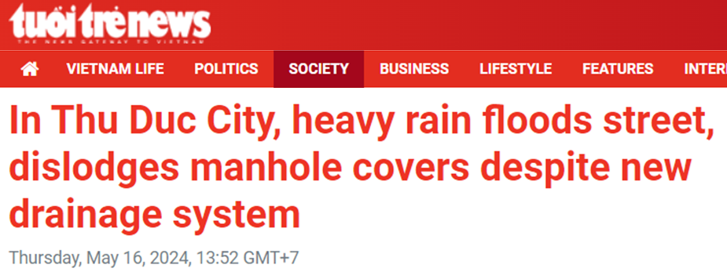
Paraphrasing
Select the best paraphrase and explain why you don’t choose the others:
A. In Thu Duc City, heavy rain floods streets and dislodges manhole covers, even with the new drainage system in some places.
B. In Thu Duc City, heavy rain frequently floods many streets and displaces their manhole covers, though its drainage system is new.
C. The heavy rain reported on May 16 flooded many streets in Thu Duc City and dislocated some manhole covers, despite the new drainage system.

Slide 11
Paraphrasing
CHAPTER 7 - ARGUMENT STANDARDIZATION
Select the best paraphrase and explain why you don’t choose the others:
Record downpours flooded homes and subway stations in the South Korean capital, killing eight people, cutting power and forcing hundreds to evacuate, according to authorities.
A. Record rainfalls heavily damaged public and private places in Seoul, causing eight deaths and a power cut, so hundreds of people were forced to move.
B. Floods caused by powerful downpours have submerged houses and underground stations in Seoul, causing eight people missing, and hundreds evacuated.
C. Torrential rainfalls in Seoul flooded buildings, causing eight deaths, power failure and extensive evacuation.

Slide 12
Filling in the missing premise or conclusion
CHAPTER 7 - ARGUMENT STANDARDIZATION
Note: Write your standardized arguments in three lines, as in the example:
Example: Bobby is a teenager so he likes fast food and soft drinks.
-> All teenagers like fast food and soft drinks. Bobby is a teenager. So, Bobby likes fast food and soft drinks.
Your turns:
1. Women are crazy about fashion so Anna is crazy about fashion.
2. True men love action more than speech. Jack is a true man.
3. Alpha Centauri is a special star because it offers life conditions similar to our solar system.
4. These materials are not confidential; therefore, no use permission is required for them.
5. Stealing is wrong. Using a friend’s car without asking is taking property without permission. So using a friend’s car without asking is wrong.

Slide 13
Filling in the missing premise or conclusion
CHAPTER 7 - ARGUMENT STANDARDIZATION
1. Women are crazy about fashion so Anna is crazy about fashion.
-> Women are crazy about fashion. Anna is a woman. So, Anna is crazy about fashion.
2. True men love action more than speech. Jack is a true man.
-> True men love action more than speech. Jack is a true man. So, Jack loves action more than speech.
3. Alpha Centauri is a special star, because it offers life conditions similar to our solar system.
-> Special stars offer life conditions similar to our solar system. Alpha Centauri offers life conditions similar to our solar system. So, Alpha Centauri is a special star.
4. These materials are not confidential; therefore, no use permission is required.
-> Use permission is required for confidential materials. These materials are not confidential; therefore, no use permission is required.
5. Stealing is wrong. Using a friend’s car without asking is taking property without permission. So using a friend’s car without asking is wrong.
-> Stealing is wrong. Stealing is taking property without permission. Using a friend’s car without asking is taking property without permission. So, using a friend’s car without asking is wrong.

Slide 14
Number the statements and diagram the argument
CHAPTER 7 - ARGUMENT DIAGRAMMING
Nearly everyone holds the same opinion about dogs. Dogs are intelligent and friendly creatures. A dog “knows” its name since it comes when it is called. If its master is away, the dog looks sad and it even skips its meals. However, the dog excitedly wags its tail and barks when its master returns. Nearly everyone holds the same opinion about dogs.
Dogs are intelligent and friendly creatures.
A dog “knows” its name
since it comes when it is called
If its master is away, the dog looks sad and it even skips its meals
the dog excitedly wags its tail and barks when its master returns
Nearly everyone holds the same opinion about dogs.

Slide 15
CHAPTER 7 - ARGUMENT DIAGRAMMING
(1) I strongly believe the next few decades will see great changes in the way energy is supplied and used. (2) Many countries are focusing on the switch to a low carbon economy. (3) The driving force is that in some major oil producing countries, 'peak oil' has already been reached, and (4) there are increasing fears of global warming. (5) As consumers switch from oil and gas to electricity to power their homes and vehicles, (6) there will be an increase in overall demand for electricity. (7)When households and communities install solar panels and small scale wind turbines for their own supply, (8)there is also likely more electricity generation centers. (9) The 2022 energy crisis has caused rocketing prices of fuel and other necessity goods.

Slide 16
CHAPTER 8: ARGUMENT REFUTATION
1. “Students should be given more homework so that they cause less trouble.”
Which of the following refutes the given argument?
A. More homework means more efforts, which are good for students’ academic achievements.
B. Students who are trouble-makers are always the ones who would not do the assigned homework.
C. Homework keeps students busy in the time at home, so they can’t watch violent movies then cause trouble.
D. Research shows that excessive homework is one of the most critical problems for all students.
Notes:
B

Slide 17
CHAPTER 8: ARGUMENT REFUTATION
2. “A school uniform should be implemented so that teachers waste less time on enforcing a dress code.”
Which of the following refutes the given argument?
A. When every student wears the same, teachers do not need to care about inappropriate clothes.
B. Students can spend more time on their clothing styles, but identity is part of children’s growth process.
C. If teachers enforce school uniform, they should wear uniform, too.
D. Students’ clothing styles do not affect their academic work, which requires more of teachers’ time.

Slide 18
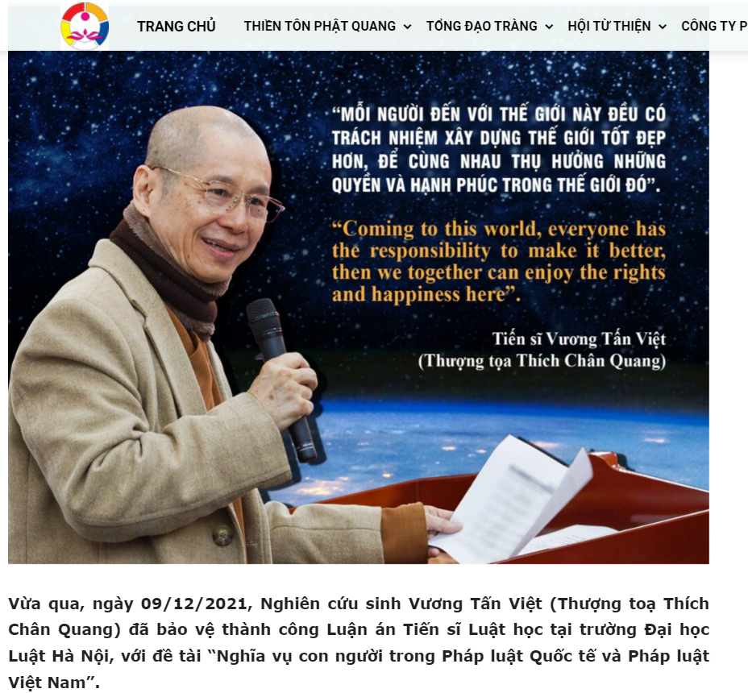
CHAPTER 8: ARGUMENT REFUTATION
Notes:
https://thientonphatquang.com/toan-van-luan-an-tien-si-luat-hoc-cua-tt-thich-chan-quang-ve-nghia-vu-con-nguoi-trong-phap-luat-quoc-te-va-phap-luat-viet-nam/

Slide 19
Find the fallacies
-Thưa thượng tọa, người ta thường đánh giá sự phát triển xã hội dựa vào chỉ số thu nhập GDP, nhưng GDP sẽ là không đủ nếu như đạo đức xã hội không được giữ gìn thậm chí xuống cấp. Thượng tọa có thể nói gì về điều này?
-Thượng tọa Thích Chân Quang: Chúng ta có thể định lượng được GDP nhưng chúng ta chưa có công cụ để định lượng được mức độ hạnh phúc của con người và đạo đức của con người và của xã hội. Mục tiêu của một xã hội là đem đến hạnh phúc cho con người, thu nhập đầu người GDP tất nhiên là quan trọng nhưng không phải là chỉ số duy nhất mà còn nhiều yếu tố khác, trong đó có đạo đức. Đạo đức là điều tốt trong tâm của chúng ta, muốn làm tốt cho người khác. Người có đạo đức là những người sống trong cuộc sống cống hiến nhiều hơn là đòi hỏi thụ hưởng.
-Đạo đức và sự thụ hưởng liên quan đến nhau ra sao?
-Thượng tọa Thích Chân Quang: Trong xã hội hiện đại thì con người đề cao sự sòng phẳng, tôi cống hiến thế này, tôi phải thụ hưởng bấy nhiêu. Tôi bỏ tiền ra như thế này, tôi phải mua được số đồ vật thế kia. Thậm chí nhiều người muốn hưởng thụ nhiều hơn sự cống hiến của họ, bỏ ra ít tiền mà muốn mua được của cải nhiều hơn người khác, lao động ít mà muốn thụ hưởng nhiều, không lao động mà cũng đòi phần thụ hưởng. Xã hội như thế sẽ không có sự thặng dư. Nếu trong xã hội mà con người cống hiến nhiều hơn sự thụ hưởng thì sẽ có sự thặng dư để lo cho tương lai.
https://tienphong.vn/thuong-toa-thich-chan-quang-dao-duc-se-tao-nen-mot-xa-hoi-thang-du-post1087095.tpo

Slide 20
CHAPTER 8: ARGUMENT REFUTATION
3. “All students should be given the right to choose to go to school or not. When they are forced to do so, there will be kids who do not want to be there and they cause trouble.”
Which of the following questions refutes the given argument?
A. Are elementary students old or wise enough to make such an important decision which will affect their future?
B. Are schools learning environments, so is it unacceptable for children to cause trouble there when they feel like doing so?
C. Do schools have the right to force students to learn?
D. Can teachers discipline students who cause trouble?

Slide 21
Chapter 11: Tips to achieve inductive strength
A. Give reasonable premises:
Large, representative samples
Firm evidence for predictions
Appropriate, popular authority
Possible causes, significant correlation
Consistent reference class
Relevant similarities & dissimilarities, diversity of sample
1. Inductive generalization
2. Predictive argument
3. Argument from authority
4. Causal argument
5. Statistical argument
6. Argument from analogy
B. Avoid extreme conclusions:
Do not use absolute words: ‘certainly’, ‘obviously’, ‘absolutely’…
→ Use ‘probably’, ‘likely’, ‘chances’…
Notes:
To make strong and cogent inductive arguments, we need reasonable premises and moderate conclusions.

Slide 22
Chapter 11: Tips to achieve inductive strength
26 Schengen countries are Austria, Belgium, Czech Republic, Denmark, Estonia, Finland, France, Germany, Greece, Hungary, Iceland, Italy, Latvia, Liechtenstein, Lithuania, Luxembourg, Malta, Netherlands, Norway, Poland, Portugal, Slovakia, Slovenia, Spain, Sweden, and Switzerland.
Germany, Spain, and Czech Republic rejected visas Vietnam’s new passport version. However, Spain reserved its decision on August 8, 2022.
France and the UK have also stated their recognition of Vietnam’s new passport version but warned holders to continually keep up with any developments. (Vietnamnews, August 8, 2022)
Task: Identify the argument pattern and evaluate its strength.
Argument 1
(Sept 1) The UK has stated its recognition of Vietnam’s new passport version. So other Schengen countries will probably recognize Vietnam’s new passport version.
→ Weak predictive argument: the UK does not belong to the Schengen countries
→ Change the reference class from the UK to other Schengen countries.
Notes:
https://vietnamnews.vn/politics-laws/1276073/spain-recognises-viet-nam-s-new-passports-reversing-earlier-decision.html

Slide 23
Chapter 11: Tips to achieve inductive strength
Task: Identify the argument pattern and evaluate its strength.
Argument 2
P1. Initially, Germany, Spain, and Czech Republic in Schengen area rejected Vietnam’s new passport version.
P2. Spain reserved its decision on August 8, 2022.
P3: Other Schengen countries have not yet rejected Vietnam’s new passport version.
So, chances are that Vietnamese tourists are accepted by most countries of Schengen area.
→ Strong statistical argument: 24/26 > 92% = “most”
Notes:
https://vietnamnews.vn/politics-laws/1276073/spain-recognises-viet-nam-s-new-passports-reversing-earlier-decision.html

Slide 24
Chapter 11: Tips to achieve inductive strength
Task: Identify the argument pattern and evaluate its strength.
Argument 3
Spain has resumed processing visas for Vietnam’s new passport holders, making 24/26 Schengen countries currently accepting this passport version.
Therefore, Vietnam’s new passport holders do not have travel restrictions in the Schengen area.
→ Weak causal argument: 92% is NOT an absolute correlation
→ Add induction indicator and a moderate quantifier: Therefore, Vietnam’s new passport holders probably do not have significant travel restrictions in the Schengen area.
Notes:
https://vietnamnews.vn/politics-laws/1276073/spain-recognises-viet-nam-s-new-passports-reversing-earlier-decision.html

Slide 25
Chapter 11: Tips to achieve inductive strength
Task: Identify the argument pattern and evaluate its strength.
Argument 4
P1. Spain has resumed processing visas for Vietnam’s new passport holders, making 24/26 Schengen countries currently accepting this passport version.
Therefore, Vietnam’s new passport is accepted in the Schengen area.
→ Weak argument from generalization: 92% is NOT the whole population
→ Add a relevant quantifier: Therefore, Vietnam’s new passport is accepted in most of the Schengen area.
Notes:
https://vietnamnews.vn/politics-laws/1276073/spain-recognises-viet-nam-s-new-passports-reversing-earlier-decision.html

Slide 26
Task: Identify the argument pattern and evaluate its strength.
Argument 5: The Spanish Embassy in Vietnam made the announcement on Monday – August 8 - 2022.
“After completing the mandatory technical consultations with the competent authorities in Spain, they have decided to recognise the new Vietnamese passport (navy blue), since it includes the essential characteristics required by international regulations.
However, since the place of birth is required information for Schengen visas, all applications with the new navy blue cover passports must present valid identification cards to prove their place of birth, the embassy noted.
Therefore, starting from today, the Embassy will resume processing visa applications from people with new passports and valid identification cards.”
→ Strong argument from authority: “competent authorities in Spain”

Slide 27
Chapter 11: Tips to achieve inductive strength
Task: Identify the argument pattern and evaluate its strength.
Argument 6
P1. 23 Schengen countries have not rejected Vietnam’s new passport version.
P2: Spain is a Schengen country and it has accepted Vietnam’s new passport.
P3: Germany and Czech Republic are Schengen countries.
Therefore, it is reasonable to assume that Germany and Czech Republic must accept Vietnam’s new passport.
→ Weak argument from analogy: one similarity is ignored: birthplace is required information for all Schengen visas and Spain requires a condition.
→ Reduce the dissimilarity by changing “must” to “should”
Notes:
https://vietnamnews.vn/politics-laws/1276073/spain-recognises-viet-nam-s-new-passports-reversing-earlier-decision.html

Slide 28
SAMPLE TEST FOR FINAL EXAM

